Slide 1


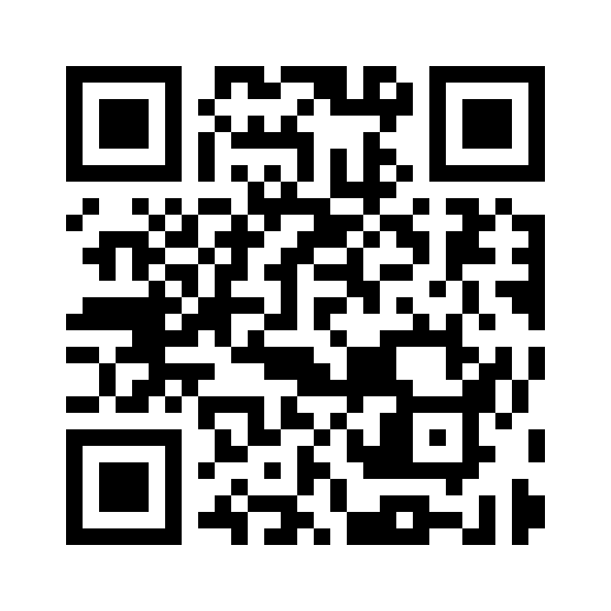


Azure Solutions Architect – IaaS
Scan this QR-code to access free resources, step-by-step learning guides as well as get practical experience in Azure Architecture - IaaS!
https://aka.ms/AA8wmlz
Don’t forget to add Microsoft Azure as a skill to your LinkedIn account to stay connected with a developer community!
+ Microsoft Azure
We post the latest announcements about free events for developers in Ireland on our official Twitter account!
@MSDevIRL

Slide 2
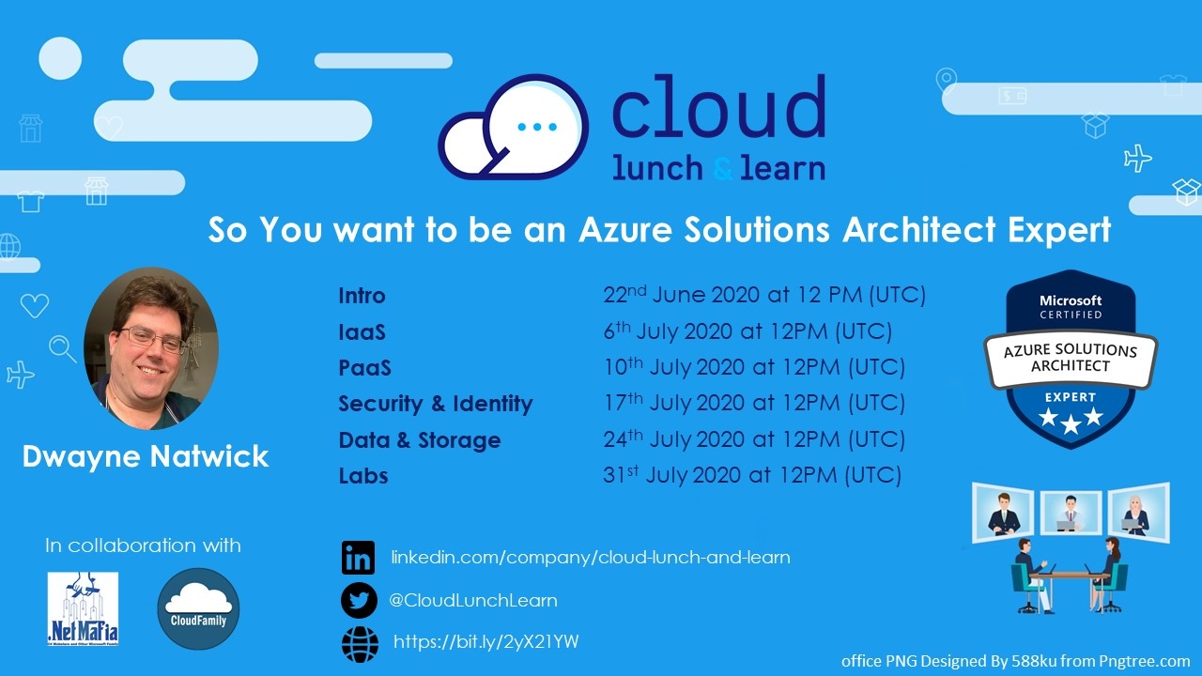

Slide 3
SO YOU WANT TO BE AN AZURE ARCHITECT EXPERT
IaaS objectives
Notes:
Thank you for joining this Cloud lunch and learn session.

Slide 4

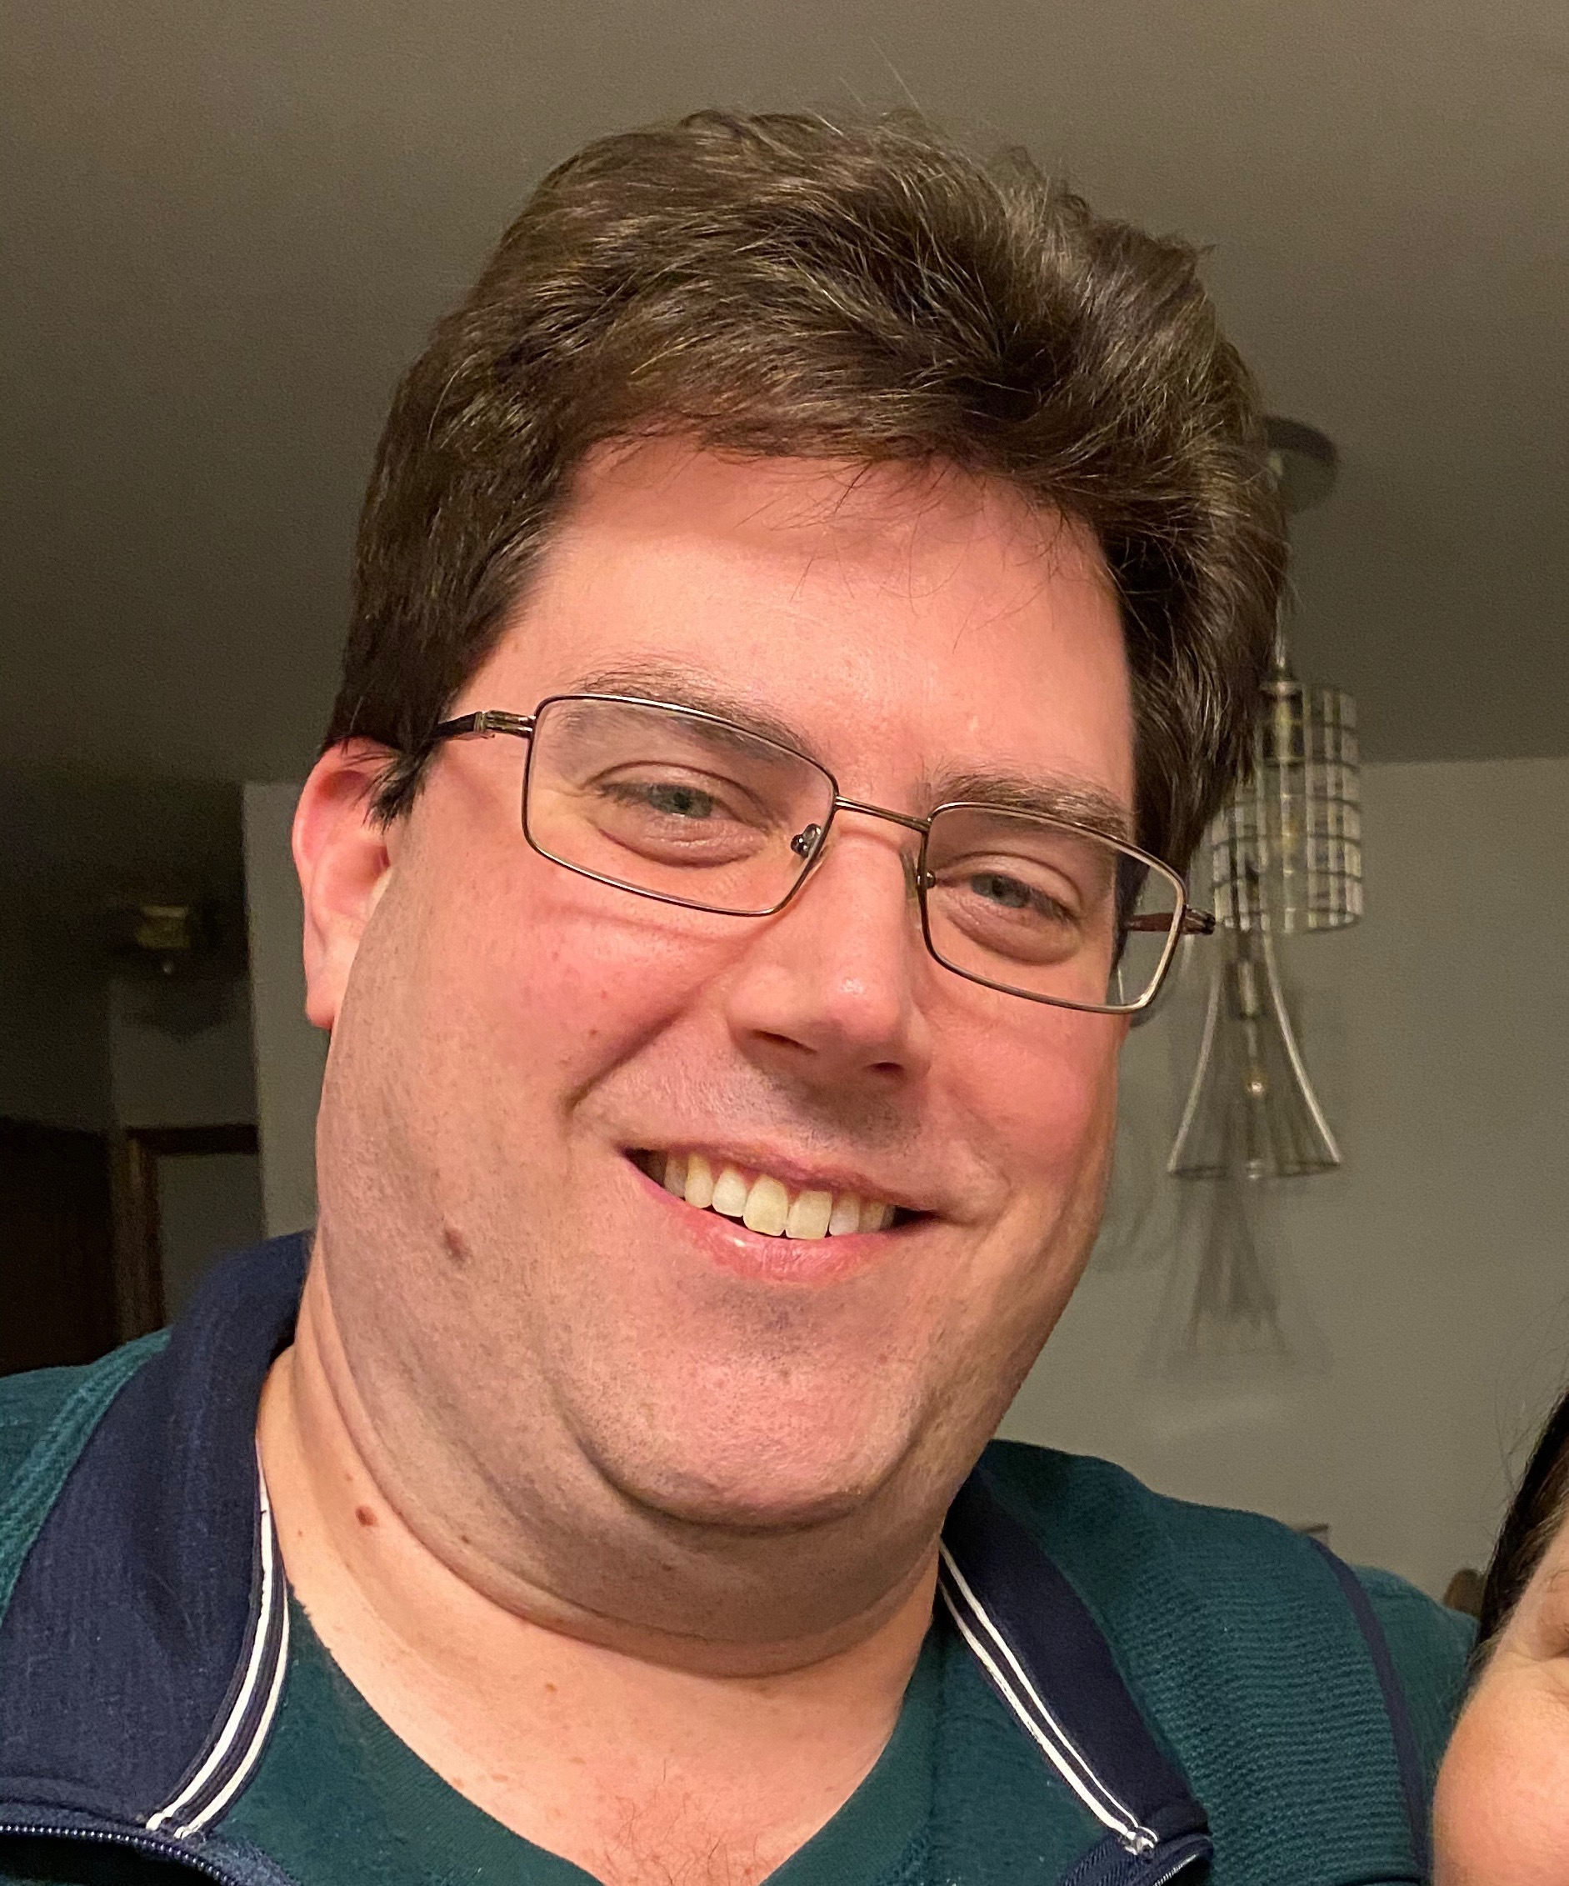

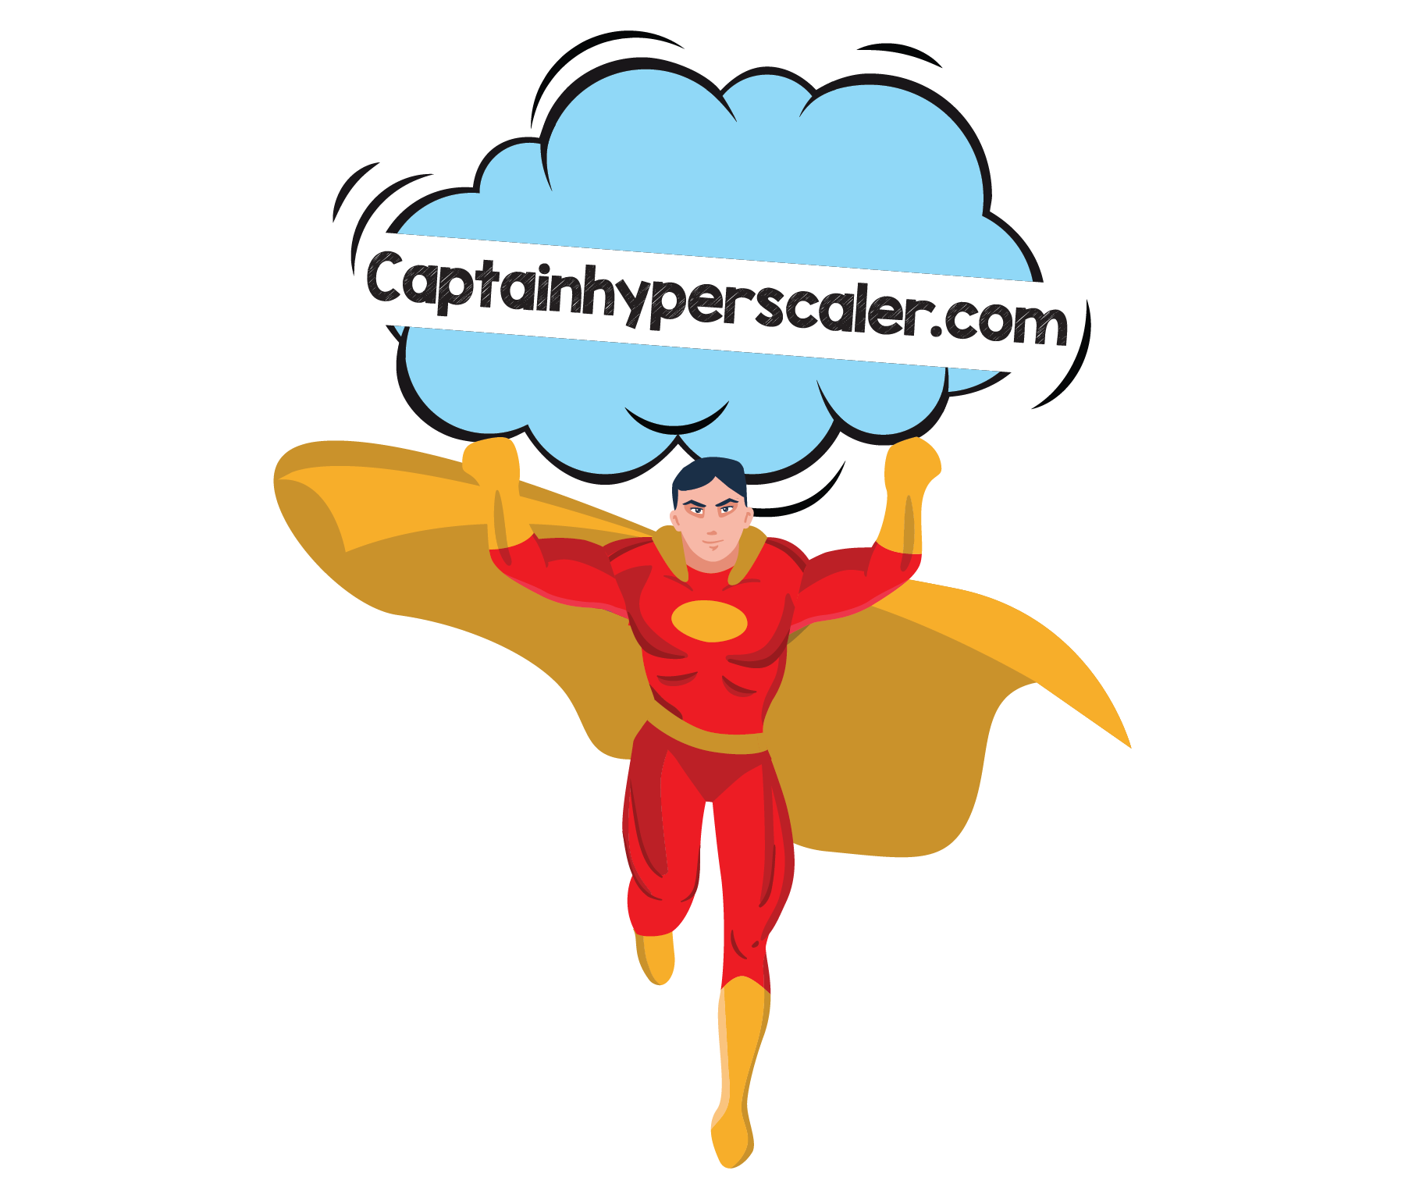
ABOUT THE AUTHOR
I am an author, trainer, and product manager with over 30 years of experience in the IT industry. I am a CISSP, PMP, and certified in multiple Azure and M365 roles, including Solution Architect Expert, Administrator Associate, and Security Engineer Associate.
In addition to creating curriculum, training, public speaking, and blog writing, I am also a Microsoft Certified Trainer and Regional Lead.
You can find me on social media at:
https://captainhyperscaler.com
http://linkedin.com/in/dnatwick
@DwayneNcloud
Dwayne Natwick
Sr. Cloud Training Architect
CISSP, PMP, 9x Azure/M365 Certified
MCT Regional Lead
Notes:
My name is Dwayne Natwick and I will be your instructor for this course. I am an author, trainer, and product manager that has been in the IT industry for over 30 years. I currently have multiple Azure and 365 role-based certifications along with my CISSP and PMP.​
​
I am a Microsoft Certified Trainer and a Regional Lead for the program. You can find me active on social media at the links provided on the slide.​

Slide 5
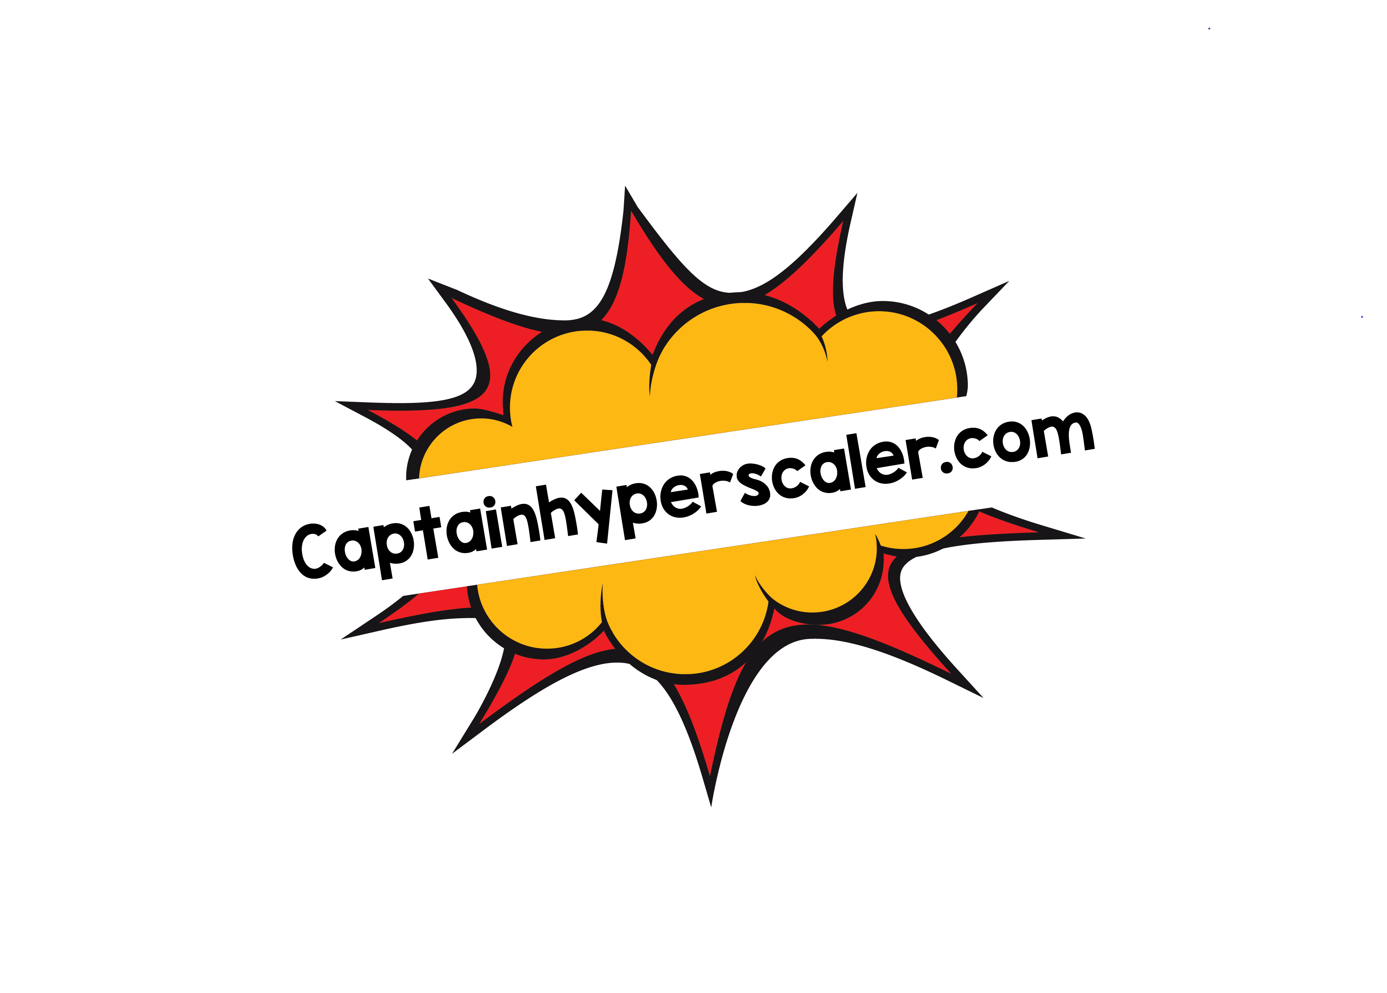
AZURE SOLUTIONS ARCHITECT EXPERT OBJECTIVES AND KEY AREAS
Azure Solutions Architect Expert certification objectives were adjusted earlier this year
Exam numbers will be changing
  AZ-300 retires on September 30, 2020, replaced by AZ-303 (beta June 29)
  AZ-301 retires on September 30, 2020, replaced by AZ-304 (beta June 29)
Passing both exams will award you with the Azure Solution Architect Expert certification (good for two years)
Objective areas by exam
  AZ-300/AZ-303: https://query.prod.cms.rt.microsoft.com/cms/api/am/binary/RE3VzwB
  AZ-301/AZ-304: https://query.prod.cms.rt.microsoft.com/cms/api/am/binary/RE3VEHD

Slide 6
MICROSOFT AZURE ARCHITECT TECHNOLOGIES (300/303 EXAM)
Objective areas:
  Deploy and configure infrastructure (40-45%)
  Implement workloads and security (25-30%)
  Create and deploy apps (5-10%)
  Implement authentication and secure data (5-10%)
  Develop for the cloud and for Azure storage (15-20%)
Very closely aligned to the AZ-104 exam
Long exam, one of the few that could take up the entire time

Slide 7
MICROSOFT AZURE ARCHITECT DESIGN (301/304 EXAM)
Objective areas:
  Determine workload requirements (10-15%)
  Design for identity and security (25-30%)
  Design a data platform solution (15-20%)
  Design a business continuity strategy (15-20%)
  Design for deployment, migration, and integration (10-15%)
  Design an infrastructure strategy (15-20%)
More design focus with case studies
Databases
Azure Site Recovery
Azure Migrate

Slide 8
IAAS TOPICS
Implement VMs for Windows and Linux
Virtual machine sizes
Managed storage for VMs
Azure Disk Encryption
Virtual Machine Desired State configuration
High availability for VMs
Virtual machine scale sets
Azure Backup
Azure Site Recovery

Slide 9
VIRTUAL MACHINES OS IN AZURE
Windows and Linux options
Windows
  Server 2016 Datacenter
  Server 2019 Datacenter
  Server 2012 R2 Datacenter
  Windows 10 Pro
Linux
  Ubuntu Server 18.04 or 16.04
  Red Hat Enterprise 8.1
  SUSE Enterprise 15
  CentOS 8.1
  Debian 10 “Buster”

Slide 10
VIRTUAL MACHINES SIZES IN AZURE
Sizing a VM in Azure – grouped by workload types
  General purpose – A, B, D
  Compute optimized - F
  Memory optimized – E, M, DSv2 (also in GP)
  Storage optimized - L
  GPU - N
  High performance compute - H
https://docs.microsoft.com/en-us/azure/virtual-machines/windows/sizes

Slide 11
STORAGE, ENCRYPTION, BASELINES
Managed disks is the recommended default for VM storage
Disk options are Standard HDD, Standard SSD, and Premium SSD for OS disks
  Ultra SSD is an additional option for some VM sizes
Azure Disk Encryption (ADE) should be implemented in order to encrypt the disk AND OS
Desired State Configuration can be used to create VM baselines
https://docs.microsoft.com/en-us/azure/security/azure-security-disk-encryption#overview

Slide 12
SCALABILITY VERSUS AVAILABILITY
Scalability
Availability
Scaling out resources
Additional resources to meet increased demand
Decreased resources to meet lower demand
Only pay for resources that are turned on
Scaling out resources
Maintain application availability across multiple resources
Decreases downtime caused by hardware issues
Pay for the resources that are running

Slide 13

VIRTUAL MACHINE SCALE SET
Scale out
Dynamic use
Pay for what is running
>CPU
>CPU
<CPU
<CPU

Slide 14
VIRTUAL MACHINE AVAILABILITY SET
Fault domain 0
Fault domain 1
Fault domain 2
Fault domains
Update domains
Increased SLA for VM
Single data center
Multi-data center zones
Multiplies by the number of virtual machines in AS
Update domain 0
Update domain 3
Update domain 4
Update domain 1
Notes:
99.9 single vm to 99.95 single dc to 99.99 for avail zone

Slide 15
WHEN WOULD YOU USE ?
Scale Sets
Availability Sets
E-commerce or shopping site
Sales or accounting application
24x7x365 operations
Mission critical applications
Global applications
Notes:
Virtual machine scale sets are extremely affective when dynamic compute resources are required.
Servers that are running an e-commerce or shopping application is a very common example. There may be very steady and low usage of resources during the months of February through October, but once November comes, there are more demands on this site as the Christmas shopping season begins and continues through January.
Having a scale set would allow for the needs to scale as the demand increases.
Another example could be a sales or accounting application that runs monthly reports. For three weeks of the month, there is a very steady use of resources, but when end of month reports are run, the demand on the application and compute resources increase and it is important that they scale out to meet this demand before resources become unavailable to users.

Slide 16
USE TOGETHER
Can scale an availability set
Minimum servers need to still match the AS config
Fault domain 0
Fault domain 1
Fault domain 2
Update domain 0
Update domain 3
Update domain 4
>CPU
<CPU
Update domain 1

Slide 17
BACKUP VERSUS REPLICATION
Storage Replication
Azure Backup
Azure Site Recovery
LRS – 3 copies
GRS – 6 copies
One copy becomes corrupt = all copies become corrupt
Soft Delete – protects against accidental deletion
Data Lifecycle Management
Recovery Services Vault
Protects against corrupt images and files
VM snapshots
Disk snapshots
Azure Files
Azure Databases
Retention policies
Recovery Services Vault
Protects against complete datacenter failures
Recover on-premises servers
Recover Azure servers
Can be used as a datacenter migration tool

Slide 18
IAAS DEMO
Creating a VM, VMSS, and Recovery Vault

Slide 19
NEXT STEPS
Take your self assessment
Microsoft Learn
Microsoft Docs
Create an Azure account for hands-on
Reach out with any questions or additional guidance
Future sessions on specific objective areas (schedule on next slide)
https://build5nines.com/free-oss-exam-self-assessment-tool/
Notes:
What should you do now.
I suggest that you start by downloading and taking the self assessment on the Azure Developer Associate exam.
Start to review the information in Microsoft docs, and take the Learning path in Microsoft Learn.
Create an Azure account for hands-on and also download Docker.
Feel free to reach out to me with any questions or additional guidance. If you would like specific objective areas to be covered in more detail, we may be able to provide sessions in the future with deeper dive into these objectives.

Slide 20
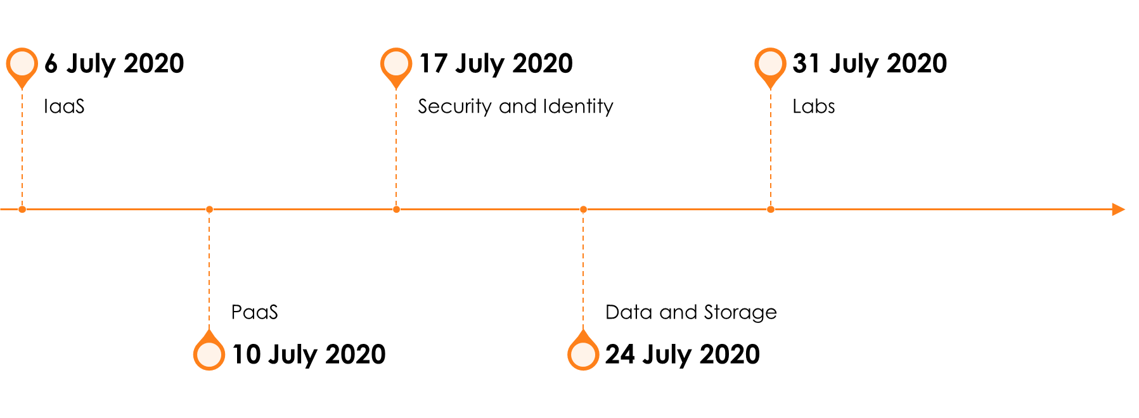
SO YOU WANT TO BE AN AZURE ARCHITECT EXPERT PREP SERIES

Slide 21
Azure Solutions Architect – IaaS
Scan this QR-code to access free resources, step-by-step learning guides as well as get practical experience in Azure Architecture - IaaS!
https://aka.ms/AA8wmlz
Don’t forget to add Microsoft Azure as a skill to your LinkedIn account to stay connected with a developer community!
+ Microsoft Azure
We post the latest announcements about free events for developers in Ireland on our official Twitter account!
@MSDevIRL

Slide 22
THANK YOU!
You can find me on social media at:
https://captainhyperscaler.com
http://linkedin.com/in/dnatwick
@DwayneNcloud
Notes:
Thank you for your time today. Feel free to reach out to me at any of the links on the screen.

